Slide 1
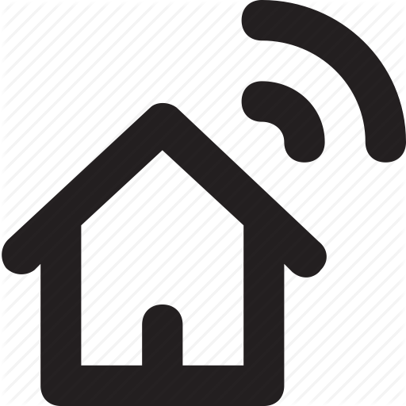



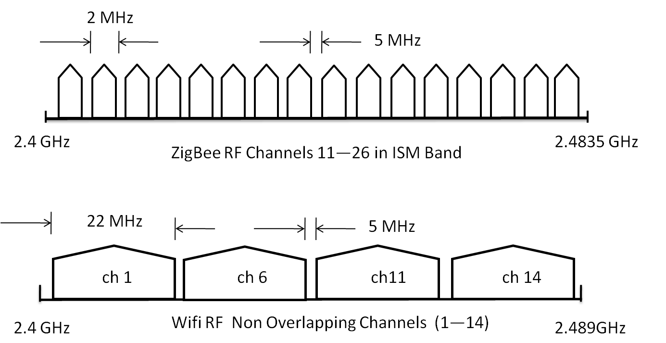




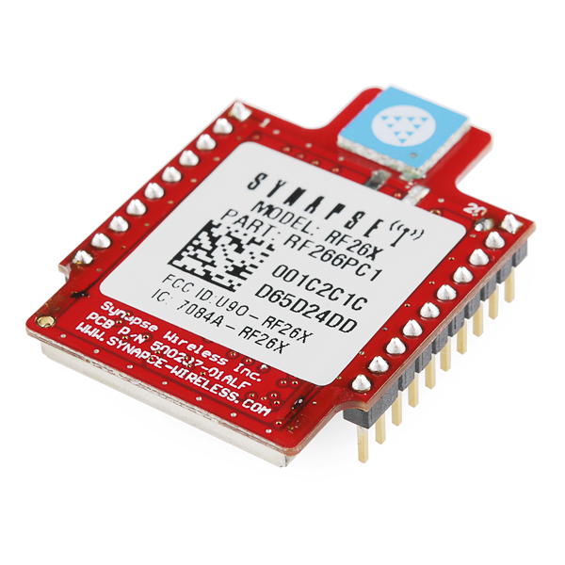














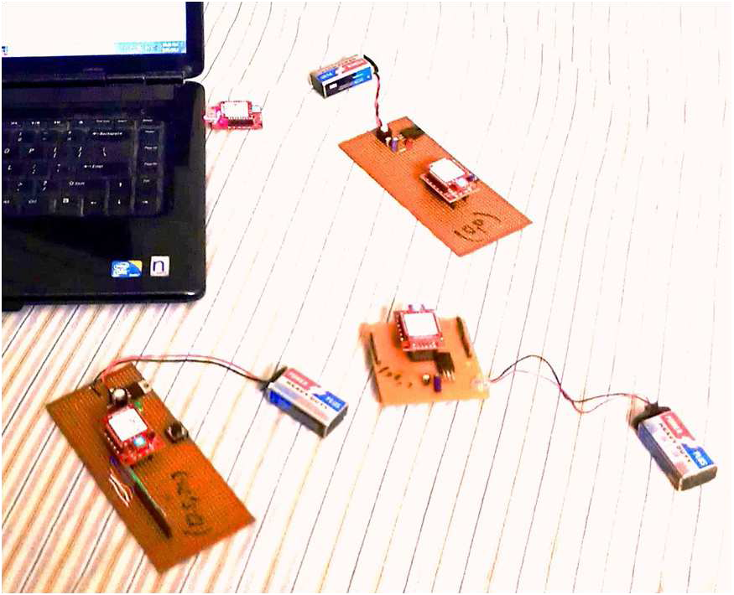
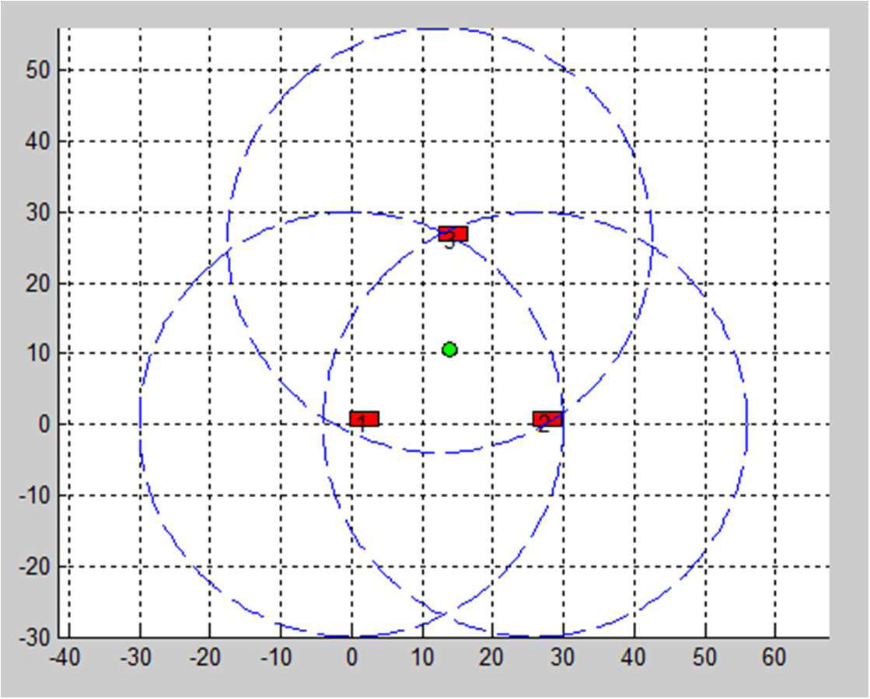
1. Motivation
2. Problem Statement
Indoor Localization
Home Automation
Healthcare
Smart Energy
Navigation
Current Practice:
Wi-Fi
Inaccurate
Meters of error
Interference
Interference
Fragile
Easily affected by dynamics
Future Promise:
ZigBee
Accurate
Programming over-the-air via PORTAL
Low cost
Mesh Networking Standard
Challenges
Low power
Cross Technology Interference
Accurate Localization
3. Approaches
4. Proposed Localization Algorithm
Centralized and Distributed Algorithms
Start
Communication cost
Distributed computation
Broadcast of Beacon signals
Range free and Range based Algorithms
ZigBee Channel Selection
Neighboring and Hop Couting
RSSI, AoA, TDoA
Not much accurate
Need extra hardware for AoA and TDoA
Anchor free and Anchor based Algorithms
Range Estimation
Global coordinates
Relative coordinates
Expensive GPS receivers
Cost effective
Location Estimation using Multilateration
Distributed, Range and Anchor based Localization Algorithm
Kalman Filter Based Error Minimization
5. Channel Selection Procedure
6. Experimental Results
Start
Energy Scan on ZigBee Channels
No
Channel Selection with Average RSSI
Experimental Setup
Data Transmission on Selected Channel
RMSE=1.6 m (Trilateration)
RMSE=0.15 m (Proposed Algorithm)
Yes
Distance (meter)
Packet Error Ratio < Threshold
Distance (meter)
Localization using Trilateration

